Slide 1
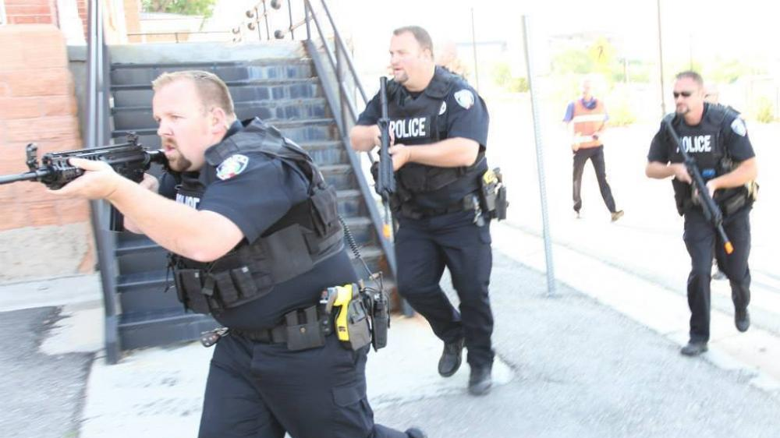
MidAmerica Nazarene University
Active Shooter Training
Presented by the MNU Campus Safety Department

Slide 2
Active Shooter Training MNU Campus Safety Department’s Goal & Commitment
The MidAmerica Nazarene University’s Campus Safety Department is committed to ensuring the safety and security of students, faculty, staff and visitors. It is the goal of the Campus Safety Department to foster a culture of safety and security throughout the university.
Safety and Security is a shared responsibility. All members of the university can help reduce the potential of crimes on campus by immediately reporting all incidents and suspicious activity to the Campus Safety Department, located at Land Gymnasium. The Campus Safety Department can be contacted 24-Hours a day at (913) 971-3299.

Slide 3
Active Shooter Training
Active Shooter situations can occur in any environment and are unpredictable and evolve quickly. There is no pattern or method to their selection of victims.
PURPOSE
The intent of the following presentation is to:
Provide guidance to those who may be caught in an Active Shooter Situation and what actions to take.
Provide guidance as to what to expect from responding Law Enforcement.
Discuss RAVE Campus Alert System
Know who to report potentially violent behavior to and their contact information
To encourage crime and incident reporting
This presentation and training is to serve as an initial point of reference for those who find themselves confronted or dealing with an Active Shooter situation.

Slide 4
Active Shooter Video- click to play

Slide 5
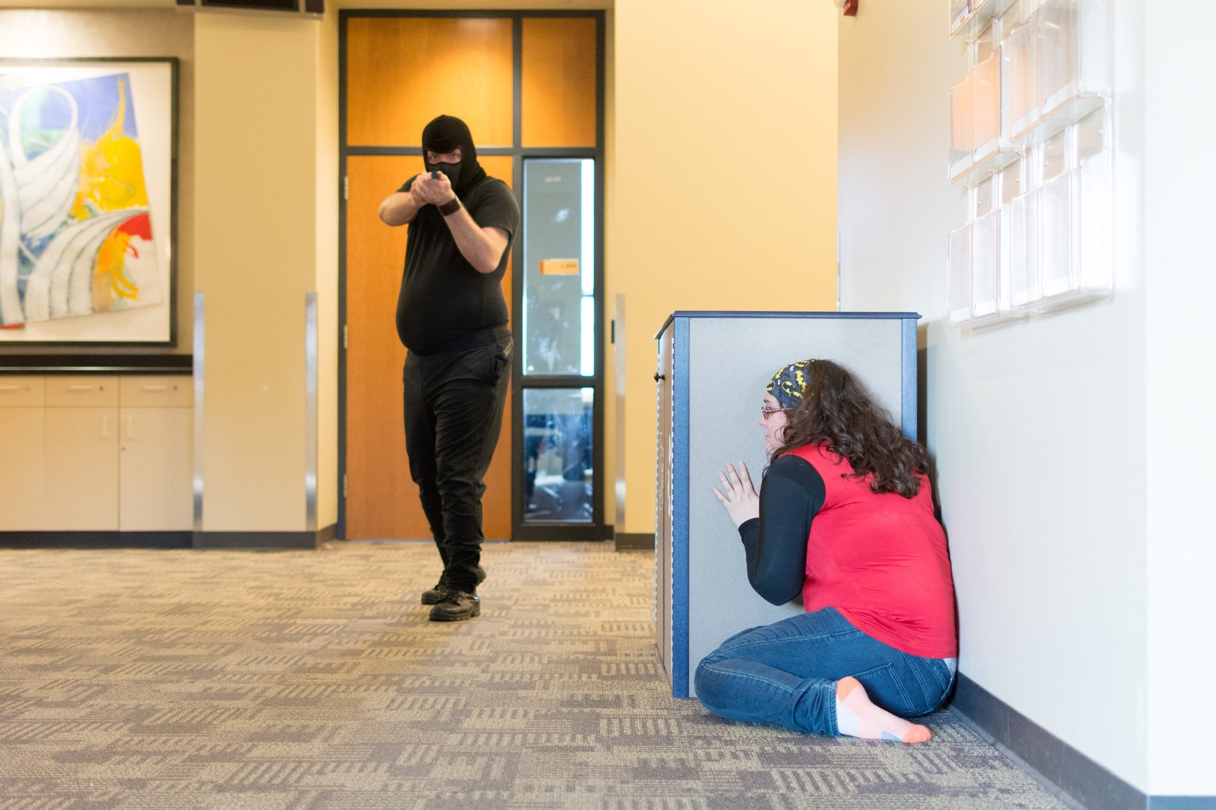
HOW TO RESPOND When an Active Shooter is in your vicinity Quickly determine the most reasonable way to protect your own life.
Run | Hide | Fight
Have an escape route and plan in mind. | Hide in an area out of the active shooter’s view | As a last resort and when your life is in imminent danger .
Leave belongings behind. | Hide behind large items | Attempt to incapacitate the Active Shooter
Keep hands visible. Follow the police officers’ instructions. | Block entry to your hiding place and lock the door if possible. | Act with physical aggression and commit to your action.

Slide 6
How to Respond
Run
Hide
Fight

Slide 7
How to Respond: RUN
Have an escape route and plan in mind.
Visualize possible escape routes, including physically accessible routes for students and staff with disabilities and others with access and functional needs;
Leave your belongings behind.
Help others escape, if possible.
Evacuate regardless of others.
Warn/prevent individuals from entering.
Avoid escalators and elevators;

Slide 8
How to Respond: HIDE
If running is not a safe option, hide in as safe a place as possible. Hide in a location where the walls might be thicker and have fewer windows.
Your hiding spot should:
Be out of the active shooter’s view.
Provide protection if shots are fired.
Not restrict options for movement.

Slide 9
How to Respond: FIGHT
As an absolute last resort:
Act as aggressively as possible.
Throw items and use improvised weapons.
Work together to incapacitate the shooter.
Commit to your actions.

Slide 10
CALL 911 WHEN SAFE TO DO SO !
Provide law enforcement or 911 operators with:
Location of shooter.
Number of shooters.
Physical description of shooters.
Number and types of weapons.
Number of potential victims.

Slide 11
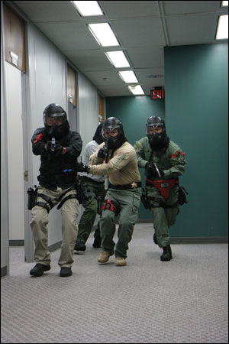
Law Enforcement’s Role when They Respond
Law Enforcement’s Immediate purpose is to:
Stop the active shooter.
Proceed to the area where last shots were heard.
Eliminate the threat as their first priority.

Slide 12
MNU Rave Campus Alert System
The MidAmerica Nazarene University has established an emergency Campus Alert System messaging service for members of our community. This method of notification is a supplement to the University’s methods of issuing timely warnings in the event of a security threat on or near our campus. In addition, this messaging service will only be used in the event of an emergency; or to advise of changes in scheduling due to severe weather; or to perform periodic testing of the system.
Students, staff, and parents can enroll by going to the website link: https://www.getrave.com/login/mnu
Staff can also access it directly from the MNU portal home page at: https://www.mnu.edu/portal by clicking on Campus Safety Department on the left-hand side then clicking on MNU Emergency Alert System Sign up-RAVE.
Students, staff, and parents are strongly encouraged to enroll their cell phone number, in addition to their email, to receive emergency alert notifications via email and cell phone texts.
The system will be tested monthly on the 1st Wednesday of every month at 11:00 AM.

Slide 13
ALERT & REPORT
ALERT THE APPROPRIATE CAMPUS SECURITY AUTHORITY IF YOU BELIEVE A STUDENT OR ANY OTHER PERSON ON CAMPUS EXHIBITS POTENTIALLY VIOLENT BEHAVIOR.

Slide 14
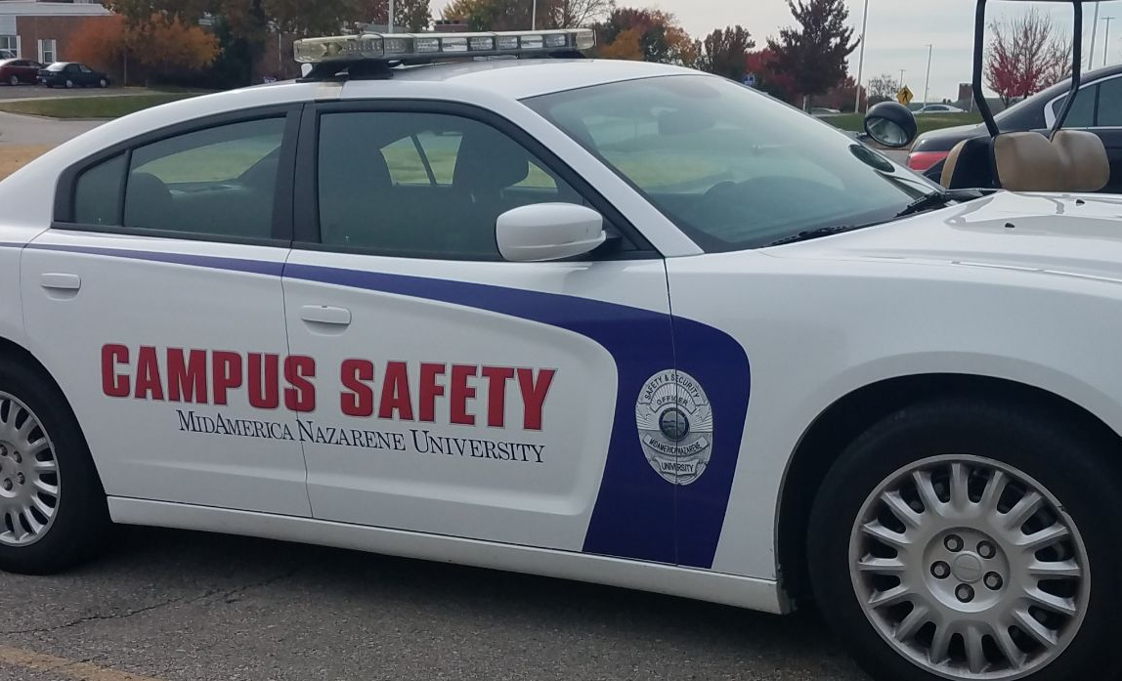
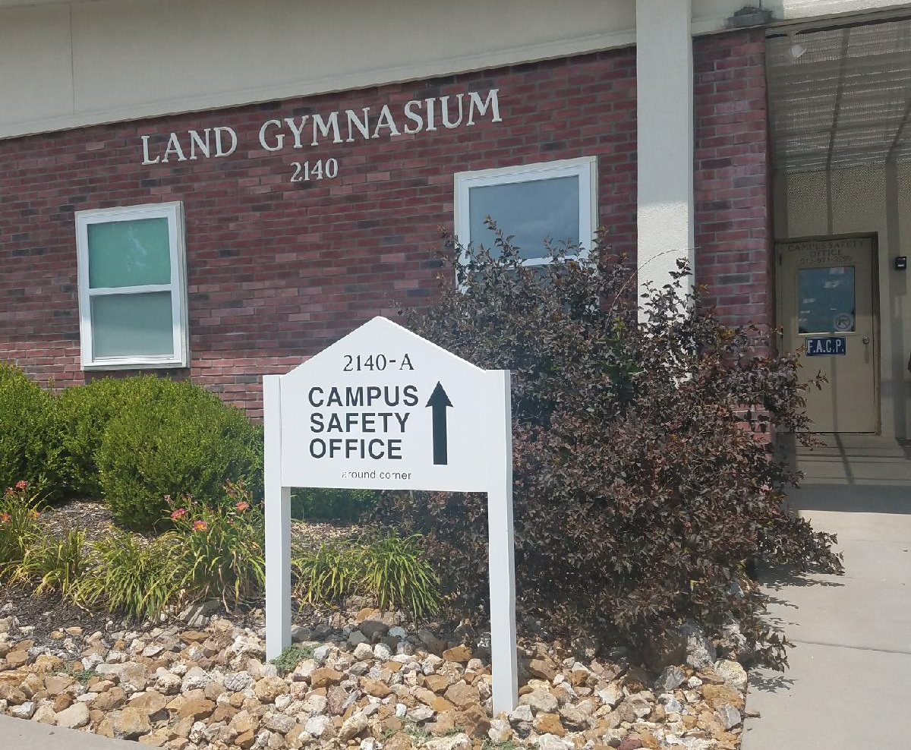
Contact Names and Numbers
MNU Campus Safety:
Office: (913) 971-3299, 24 hours
Located in Land Gym
Email: Cpolice@mnu.edu
Olathe Police Department:
Non-Emergency (913) 782-0720
Emergency Dial 911
From MNU Landline: 9-911
Director of Student Counseling and Wellness:
Elizabeth Diddle
Office: (913) 971-3251
Email: wellness@mnu.edu

Slide 15
Contact Names and Numbers
Director of Residential Life: Daniel Rincones
Office: (913) 971-3297
Email: dsrinones@mnu.edu
Vice President of Student Development/Title IX Coordinator: Kristi Keeton
Office: (913) 971-3297
Email: kkeeton@mnu.edu
Location: Campus Center
Location: Campus Center

Slide 16
Reporting Crimes & Information Anonymously
Students, faculty, and staff may provide a voluntary and confidential witness report to the Campus Safety Department. Reports may be completed to report anonymous tips concerning campus safety or to provide a confidential witness report at the following MNU Campus Safety Department webpage, under the Report a Crime link: https://www.mnu.edu/resources/campus-safety

Slide 17
Crime & Incident Reporting
Report all crimes.
Report all suspicious activity.

